Slide 1
Greedy Algorithms

Slide 2
Greedy Algorithm
Greedy approach always makes the choice that seems to be the best at that moment.
This locally optimal choice may lead to a globally optimal solution (i.e. an optimal solution to the entire problem).
The greedy method is quite powerful and works well for a wide range of problems
Notes:
Elements of dynamic programming 15.3

Slide 3
When can we use Greedy algorithms?
We can use a greedy algorithm when the following are true:
The greedy choice property: A globally optimal solution can be arrived at by making a locally optimal (greedy) choice.
The optimal substructure property: The optimal solution contains within its optimal solutions to subproblems.
Assume that you have an objective function that needs to be optimized (either maximized or minimized) at a given point. A Greedy algorithm makes greedy choices at each step to ensure that the objective function is optimized. The Greedy algorithm has only one shot to compute the optimal solution so that it never goes back and reverses the decision.

Slide 4
Designing Greedy Algorithms
Cast the optimization problem as one for which:
  we make a choice and are left with only one subproblem to solve
Prove the GREEDY CHOICE
  that there is always an optimal solution to the original problem that makes the greedy choice
Prove the OPTIMAL SUBSTRUCTURE:
  the greedy choice + an optimal solution to the resulting subproblem leads to an optimal solution

Slide 5
Example: Making Change
Instance: amount (in cents) to return to customer
Problem: do this using fewest number of coins
Example:
  Assume that we have an unlimited number of coins of various denominations:
      1c (pennies), 5c (nickels), 10c (dimes), 25c (quarters), 1$ (loonies)
  Objective: Pay out a given sum $5.64 with the smallest number of coins possible.

Slide 6
Exercise
Prove that the fractional knapsack problem has the greedy-choice property.
Show how to solve the fractional knapsack problem in O(n) time.

Slide 7
The Coin Changing Problem
Assume that we have an unlimited number of coins of various denominations:
    1c (pennies), 5c (nickels), 10c (dimes), 25c (quarters), 1$ (loonies)
Objective: Pay out a given sum S with the smallest number of coins possible.
The greedy coin changing algorithm:
    This is a Θ(m) algorithm where m = number of denominations.
  while S > 0 do
  c := value of the largest coin no larger than S;
  num := S / c;
  pay out num coins of value c;
  S := S - num*c;

Slide 8
Example: Making Change
E.g.:
$5.64 = $2 +$2 + $1 +
.25 + .25 + .10 +
.01 + .01 + .01 +.01

Slide 9
Making Change – A big problem
Example 2: Coins are valued $.30, $.20, $.05, $.01
  Does not have greedy-choice property, since $.40 is best made with two $.20’s, but the greedy solution will pick three coins (which ones?)

Slide 10

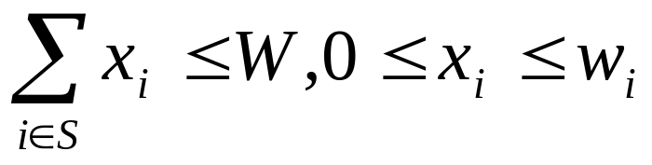
The Fractional Knapsack Problem
Given: A set S of n items, with each item i having
  b_{i} - a positive benefit
  w_{i} - a positive weight
Goal: Choose items with maximum total benefit but with weight at most W.
If we are allowed to take fractional amounts, then this is the fractional knapsack problem.
  In this case, we let x_{i} denote the amount we take of item i
  Objective: maximize
  Constraint:

Slide 11
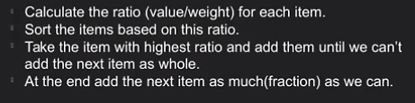
Steps in fractional Knapsack

Slide 12

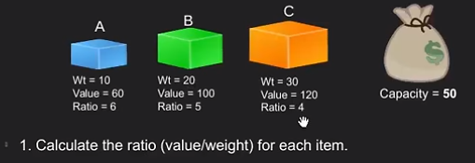
Example

Slide 13
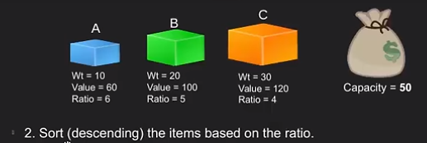
Example (cont..)

Slide 14
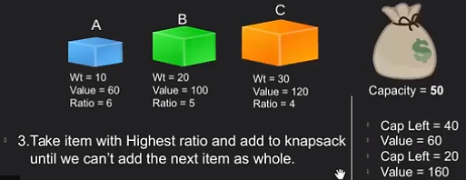
Example (cont..)

Slide 15
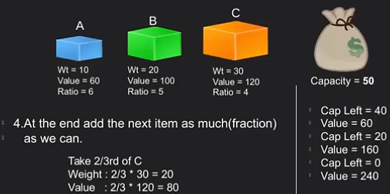
Example (cont..)

Slide 16

Example
Given: A set S of n items, with each item i having
  b_{i} - a positive benefit
  w_{i} - a positive weight
Goal: Choose items with maximum total benefit but with total weight at most W.
“knapsack”
Solution: P
1 ml of 5 50$
2 ml of 3 40$
6 ml of 4 30$
1 ml of 2 4$
Total Profit:124$
Items:
1
2
3
4
5
Weight:
4 ml
8 ml
2 ml
6 ml
1 ml
Benefit:
$12
$32
$40
$30
$50
10 ml
Value:
3
4
20
5
50
($ per ml)

Slide 17

The Fractional Knapsack Algorithm
Greedy choice: Keep taking item with highest value (benefit to weight ratio)
  Since
Algorithm fractionalKnapsack(S, W)
Input: set S of items w/ benefit b_{i} and weight w_{i}; max. weight W
Output: amount x_{i} of each item i to maximize benefit w/ weight at most W
for each item i in S
  x_{i} ← 0
  v_{i} ← b_{i} / w_{i} {value}
  w ← 0 {total weight}
  while w < W
  remove item i with highest v_{i}
  x_{i} ← min{w_{i} , W - w}
  w ← w + min{w_{i} , W - w}

Slide 18
The Fractional Knapsack Algorithm
Running time: Given a collection S of n items, such that each item i has a benefit b_{i} and weight w_{i}, we can construct a maximum-benefit subset of S, allowing for fractional amounts, that has a total weight W in O(nlogn) time.
  Use heap-based priority queue to store S
  Removing the item with the highest value takes O(logn) time
  In the worst case, need to remove all items

Slide 19
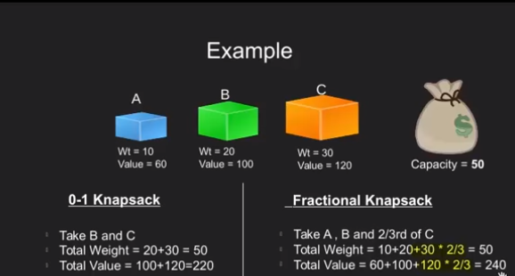
Greedy vs DP
Which one gives better solution for Knapsack problem?

Slide 20
Huffman Codes
Widely used technique for data compression
Assume the data to be a sequence of characters
Looking for an effective way of storing the data
Binary character code
  Uniquely represents a character by a binary string

Slide 21
Fixed-Length Codes
E.g.: Data file containing 100,000 characters
3 bits needed
a = 000, b = 001, c = 010, d = 011, e = 100, f = 101
Requires: 100,000 ⋅ 3 = 300,000 bits
 | a | b | c | d | e | f
Frequency (thousands) | 45 | 13 | 12 | 16 | 9 | 5

Slide 22
Huffman Codes
Idea:
  Use the frequencies of occurrence of characters to build a optimal way of representing each character
 | a | b | c | d | e | f
Frequency (thousands) | 45 | 13 | 12 | 16 | 9 | 5

Slide 23
Variable-Length Codes
E.g.: Data file containing 100,000 characters
Assign short codewords to frequent characters and long codewords to infrequent characters
a = 0, b = 101, c = 100, d = 111, e = 1101, f = 1100
(45 ⋅ 1 + 13 ⋅ 3 + 12 ⋅ 3 + 16 ⋅ 3 + 9 ⋅ 4 + 5 ⋅ 4)⋅ 1,000
= 224,000 bits
 | a | b | c | d | e | f
Frequency (thousands) | 45 | 13 | 12 | 16 | 9 | 5

Slide 24
Prefix Codes
Prefix codes:
  Codes for which no codeword is also a prefix of some other codeword
  Better name would be “prefix-free codes”
We can achieve optimal data compression using prefix codes
  We will restrict our attention to prefix codes

Slide 25
Encoding with Binary Character Codes
Encoding
  Concatenate the codewords representing each character in the file
E.g.:
  a = 0, b = 101, c = 100, d = 111, e = 1101, f = 1100
  abc = 0 ⋅ 101 ⋅ 100 = 0101100

Slide 26
Decoding with Binary Character Codes
Prefix codes simplify decoding
  No codeword is a prefix of another ⇒ the codeword that begins an encoded file is unambiguous
Approach
  Identify the initial codeword
  Translate it back to the original character
  Repeat the process on the remainder of the file
E.g.:
  a = 0, b = 101, c = 100, d = 111, e = 1101, f = 1100
  001011101 =
0
⋅ 0
⋅ 101
⋅ 1101
= aabe

Slide 27
Prefix Code Representation
Binary tree whose leaves are the given characters
Binary codeword
  the path from the root to the character, where 0 means “go to the left child” and 1 means “go to the right child”
Length of the codeword
  Length of the path from root to the character leaf (depth of node)
100
100
0
1
0
1
86
14
a: 45
55
0
1
0
0
1
25
30
58
28
14
0
1
0
1
0
1
0
1
0
1
c: 12
b: 13
14
d: 16
a: 45
b: 13
c: 12
d: 16
e: 9
f: 5
0
1
f: 5
e: 9

Slide 28
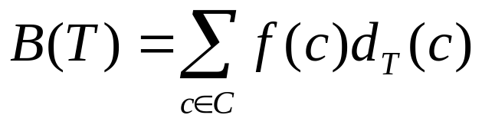
Optimal Codes
An optimal code is always represented by a full binary tree
  Every non-leaf has two children
  Fixed-length code is not optimal, variable-length is
How many bits are required to encode a file?
  Let C be the alphabet of characters
  Let f(c) be the frequency of character c
  Let d_{T}(c) be the depth of c’s leaf in the tree T corresponding to a prefix code
the cost of tree T

Slide 29
Constructing a Huffman Code
A greedy algorithm that constructs an optimal prefix code called a Huffman code
Assume that:
  C is a set of n characters
  Each character has a frequency f(c)
  The tree T is built in a bottom up manner
Idea:
  Start with a set of |C| leaves
  At each step, merge the two least frequent objects: the frequency of the new node = sum of two frequencies
  Use a min-priority queue Q, keyed on f to identify the two least frequent objects
f: 5
e: 9
c: 12
b: 13
d: 16
a: 45

Slide 30
Example
f: 5
e: 9
c: 12
b: 13
d: 16
a: 45
c: 12
b: 13
14
d: 16
a: 45
0
1
f: 5
e: 9
14
d: 16
25
a: 45
25
30
a: 45
0
1
0
1
0
1
0
1
f: 5
e: 9
c: 12
b: 13
c: 12
b: 13
14
d: 16
0
1
f: 5
e: 9
55
0
100
1
a: 45
0
1
a: 45
55
25
30
0
1
0
1
0
1
25
30
c: 12
b: 13
14
d: 16
0
1
0
1
0
1
c: 12
b: 13
14
d: 16
f: 5
e: 9
0
1
f: 5
e: 9

Slide 31
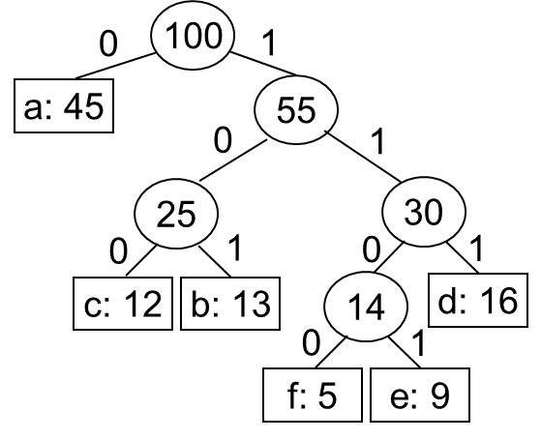
Encoding and Decoding
Encode the string: cdf
Replace each character to
its corresponding code
  cdf=1001111100
Decode for: 1001111100
  Start from root node to leaf node based
  on the codes to find target character:
  cdf
Traverse root to every leaf node then get,
  a=0,
  b=101,
  c=100,
  d=111,
  e=1101
  f=1100,

Slide 32
Building a Huffman Code
Alg.: HUFFMAN(C)
n ← ⎜C ⎜
Q ← C
for i ← 1 to n – 1
do allocate a new node z
left[z] ← x ← EXTRACT-MIN(Q)
right[z] ← y ← EXTRACT-MIN(Q)
f[z] ← f[x] + f[y]
INSERT (Q, z)
return EXTRACT-MIN(Q)
Running time: O(nlgn)
O(n)
O(nlgn)

Slide 33
Thanks All

